Slide 1

Topic: Semaphores
Lecture: Dr. Zhao Jie
Date: 04/15/2025

Slide 2
Reading Assignment
Chapters 31

Slide 3
Agenda
Semaphore
Parent waiting for child
Bounded buffer between producer and consumer
Philosopher dining problem

Slide 4
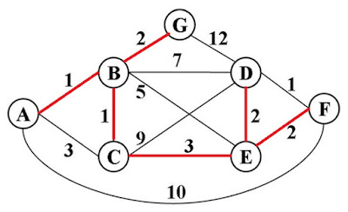
The motivation
Inventor
Edsger Dijkstra, who introduced the “shortest paths” algorithm in graph theory [1]
Background
Both locks and condition variables are necessary to solve the concurrency problem.
[1] https://www.exploredatabase.com/2021/06/find-single-source-shortest-path-using-Dijkstras-algorithm.html

Slide 5
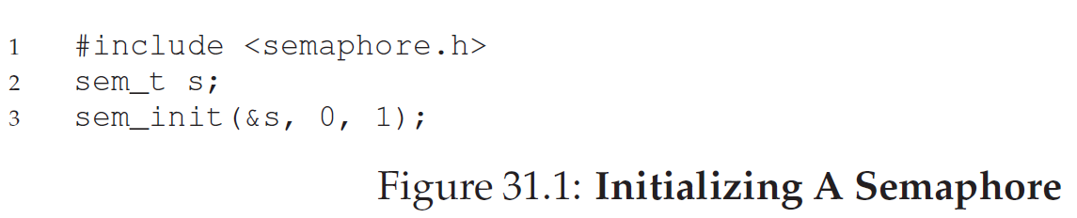
Definition of Semaphore
Definition
An object with an integer value
sem_wait( ) – decremental the value and the caller’s self-sleep if negative
sem_post( ) – incremental the value and the caller’s being woken
Init function
Func: Initialize a semaphore
Arg2: set the value by 0, Semaphore is shared with all threads in the same process.
Arg3: Pass value 1 to the 3rd argument

Slide 6
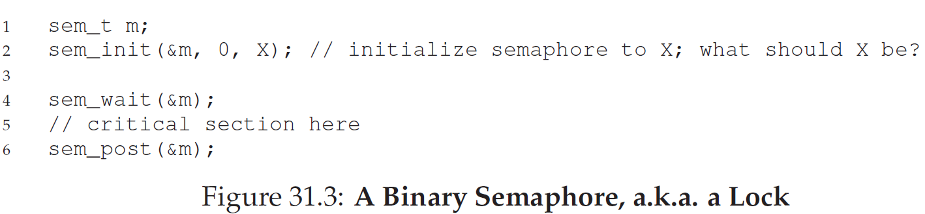
Binary semaphore (lock)
Implementation
Explanation
X value is 1.
When sem_wait() is triggered by one thread, the value is decremental, and the thread enters the critical section. This time, when the 2nd thread wants to enter the critical section using the lock, the 2nd thread has to pair-wise use sem_wait() and sem_post(). This means the 2nd thread needs to call sem_wait(). Since the value becomes 0, after decrement, the value will be negative, which will make the 2nd thread self-sleep.

Slide 7
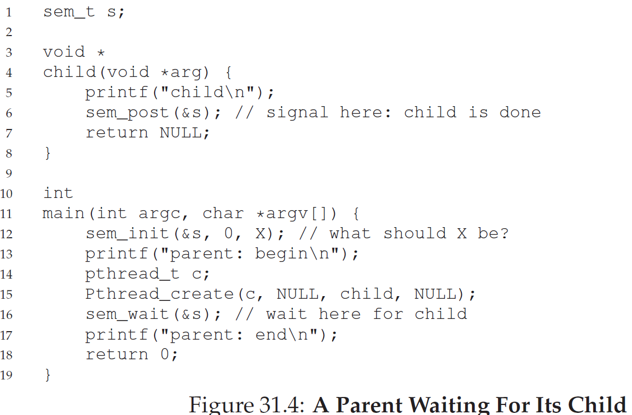
Semaphores for ordering - 1

Slide 8
Semaphores for ordering - 2
Explanation
X value is 0.
Both sem_init() and sem_wait() are in parent thread, and sem_post() is in child thread.
When the parent thread first runs, the parent thread will trigger sem_wait(). Thus, the value will be decremented and become -1, and the parent thread will self-sleep until the child thread induces sem_post() to wake the parent thread.
When the child thread runs at first, the child thread will trigger sem_post(). The value, after incrementing, will become 1. Then, the parent runs at second and triggers sem_wait(). The value will decrement and become 0. Due to the value, the parent thread will continue running rather than self-sleep.

Slide 9
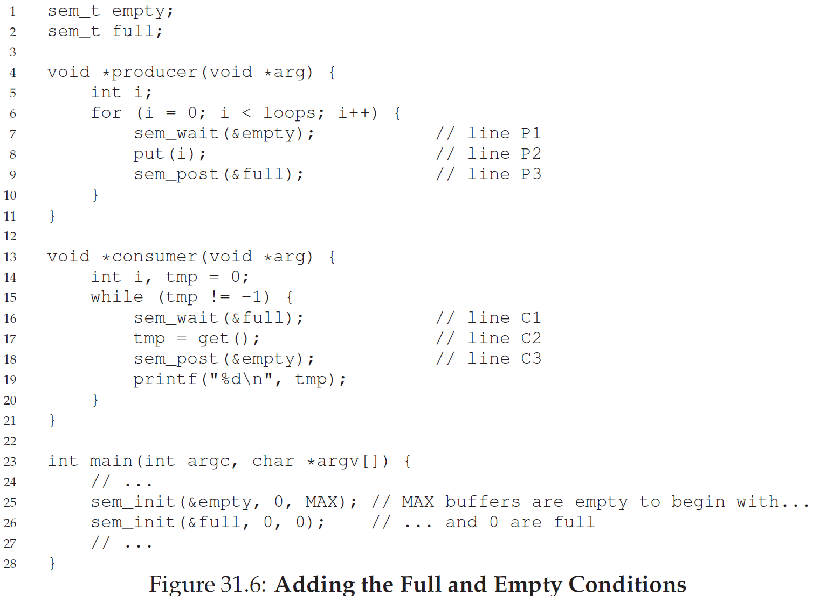
Semaphores for bounded buffer - 1

Slide 10
Semaphores for bounded buffer - 2
Explanation
MAX value is 1.
The semaphore mechanism is that the producer must run at first and that the consumer runs at second.
How does it work? As the MAX value is 1, it guarantees the producer runs first by the semaphore “empty”. The producer won’t be blocked by sem_wait() and thus directly sends the data to the buffer by calling put(). On the other hand, the consumer will run secondly by the semaphore “full”. In turn, the consumer won’t get the data from the buffer until the producer calls sem_post(full).
New issue
What about multi-producers and multi-consumers? – race condition

Slide 11
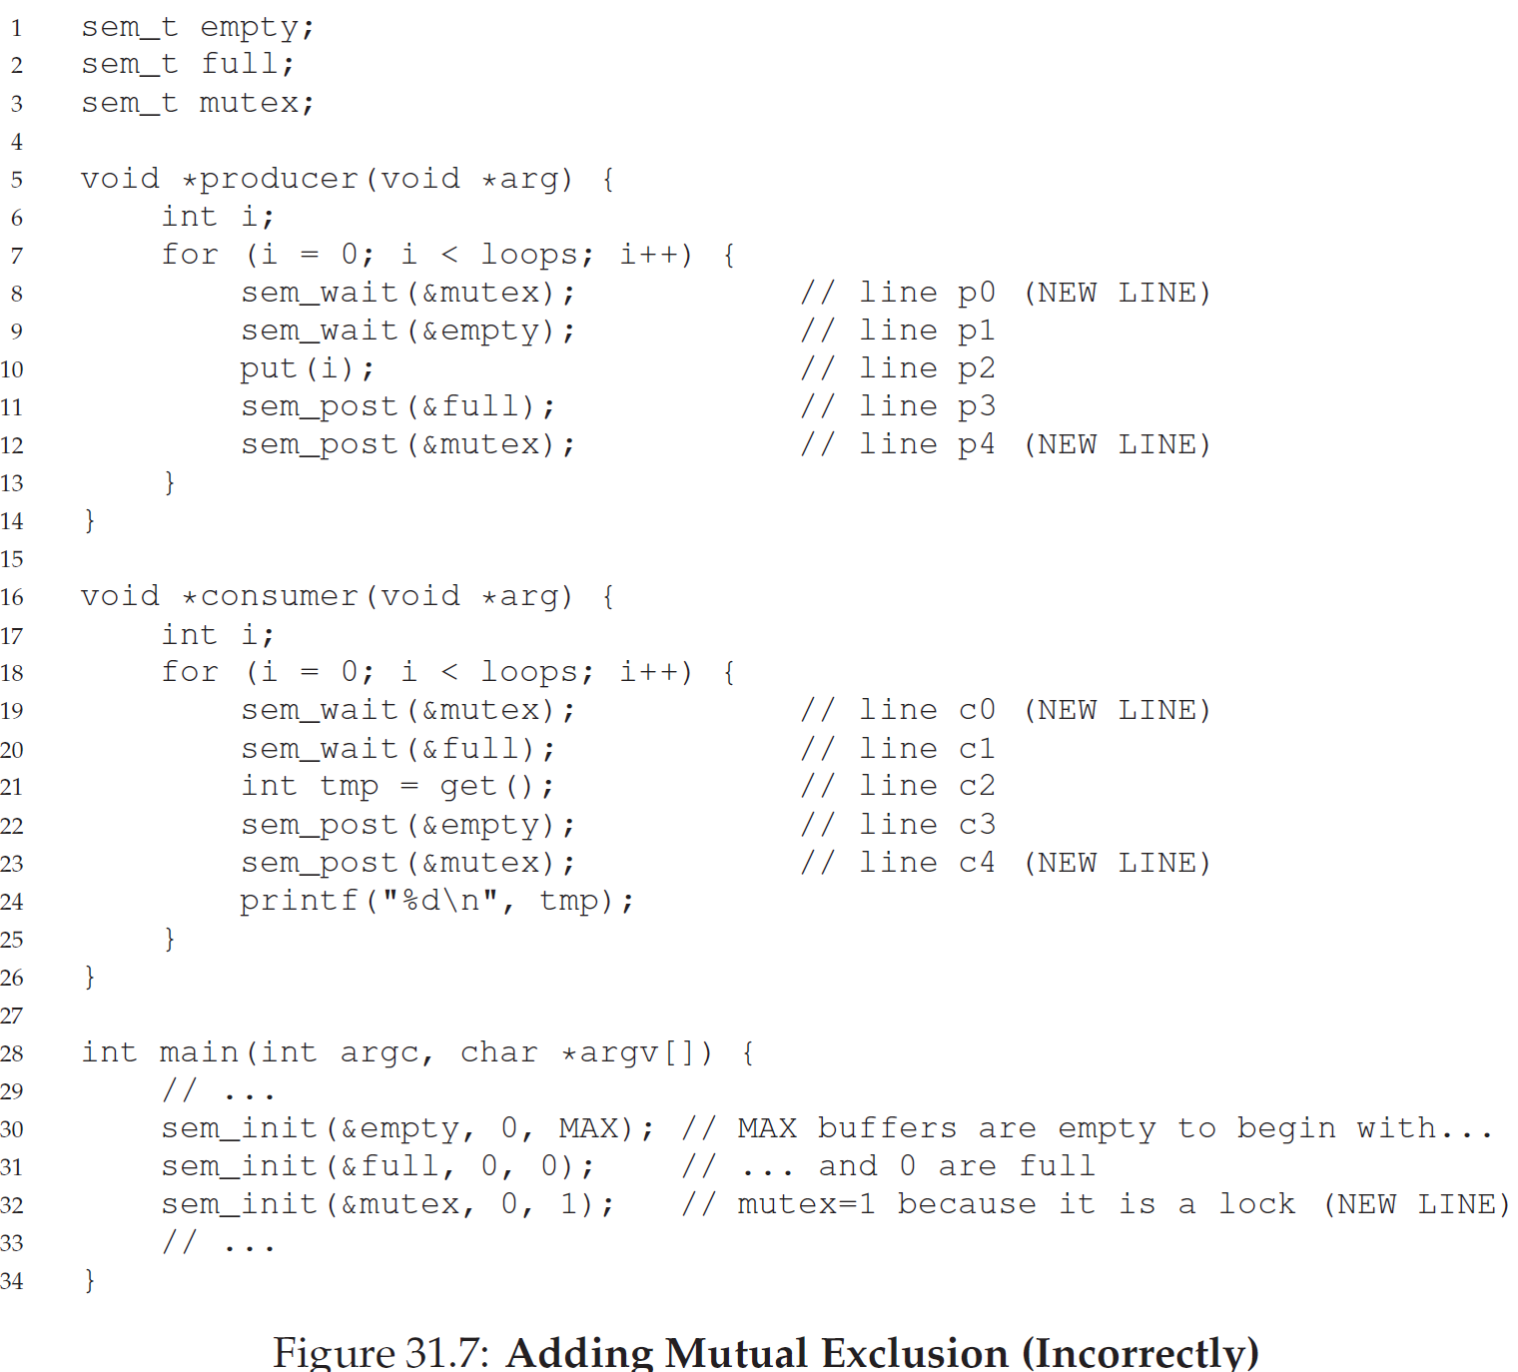
bounded buffer with deadlock- 3

Slide 12
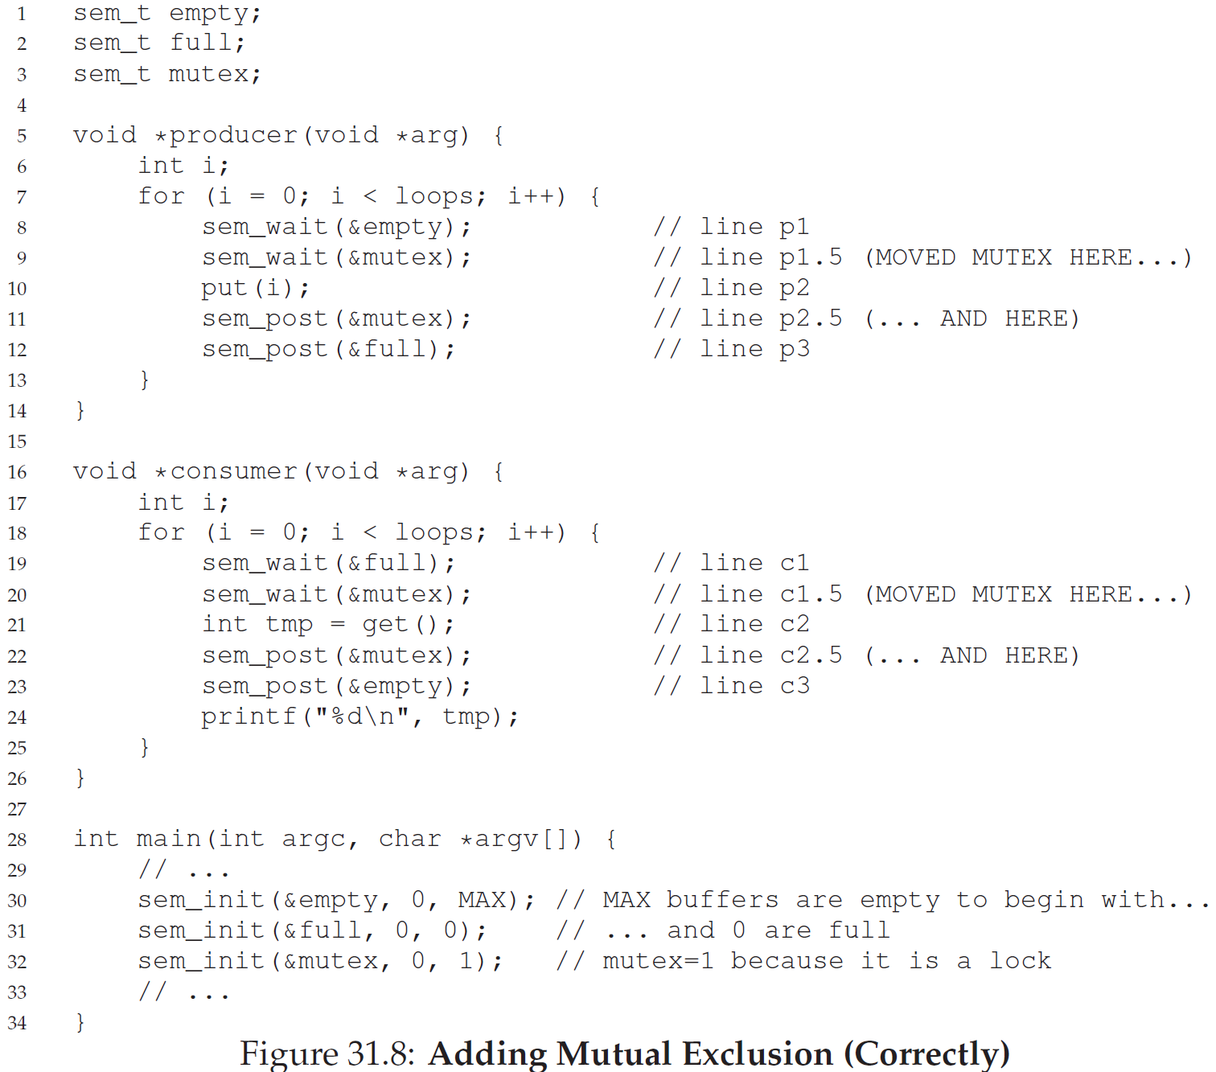
Correct bounded buffer - 4

Slide 13
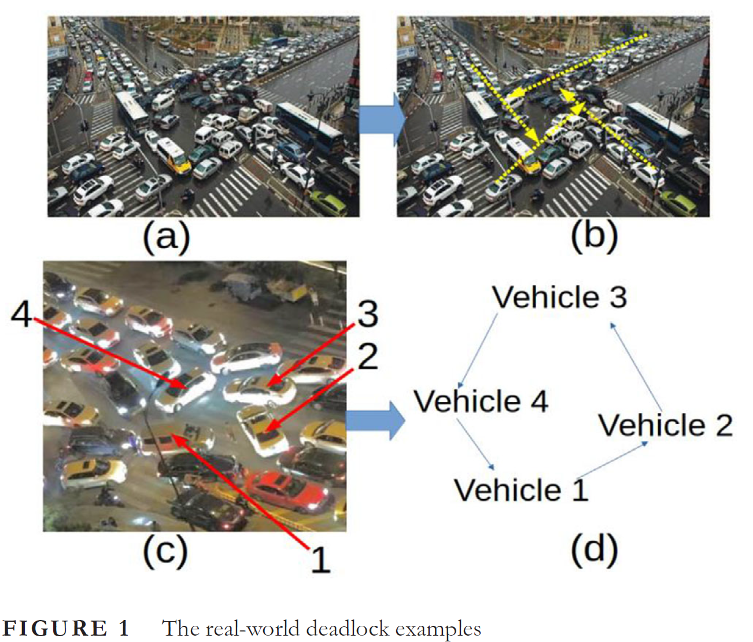
Deadlock – 1 [1] [1] Qi, H., et al. "Deadlock detection, cooperative avoidance and recovery protocol for mixed autonomous vehicles in unstructured environment.

Slide 14
Deadlock - 2
Definition [1]
In an operating system, a deadlock occurs when a process or thread enters a waiting state because a requested system resource is held by another waiting process, which in turn is waiting for another resource held by another waiting process.
If a process remains indefinitely unable to change its state because the resources it requests are being used by another process that itself is waiting, then the system is said to be in a deadlock.
[1]. https://en.wikipedia.org/wiki/Deadlock_(computer_science)

Slide 15
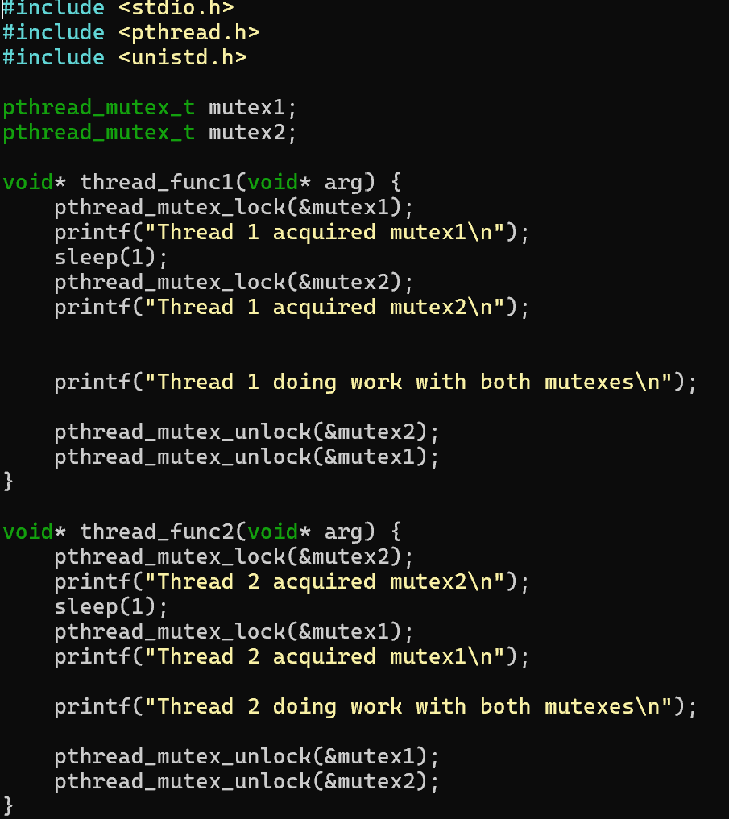
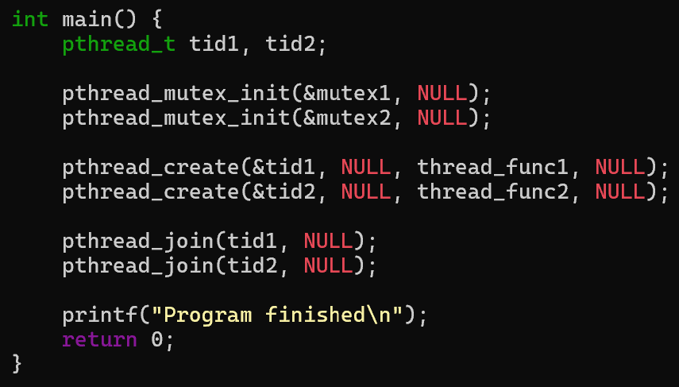
Deadlock – 3
Deadlock example

Slide 16
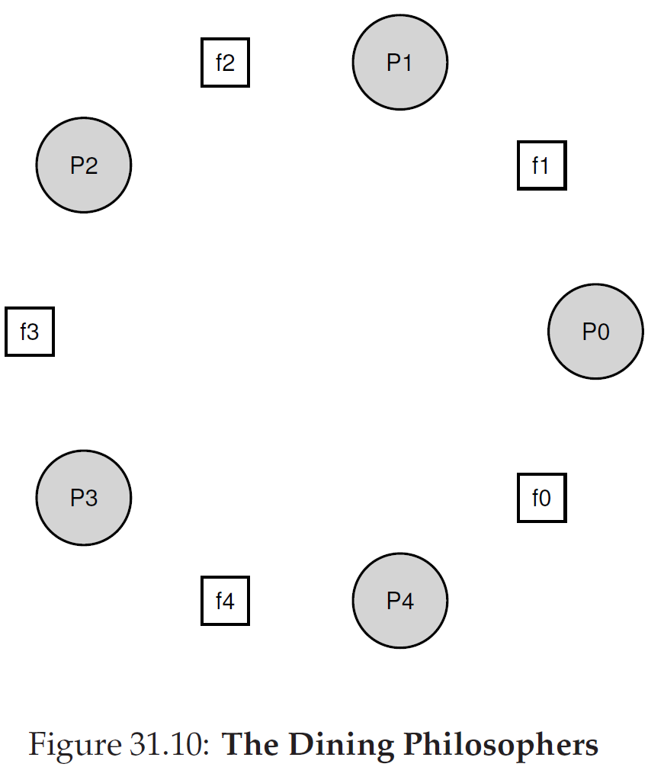
The dining philosopher problem
Problem description
Pi: each philosopher
fi: each fork
Pi must hold two trajectory forks for eating.
Pi won’t eat when calling think() and eating when calling eat().

Slide 17
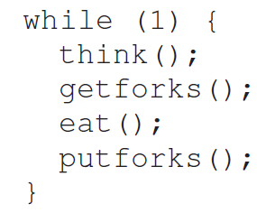

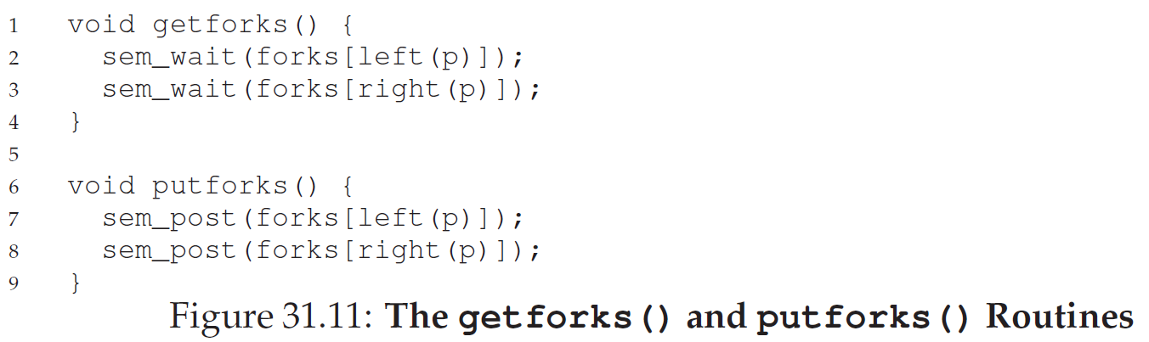
The dining philosopher implementation

Slide 18
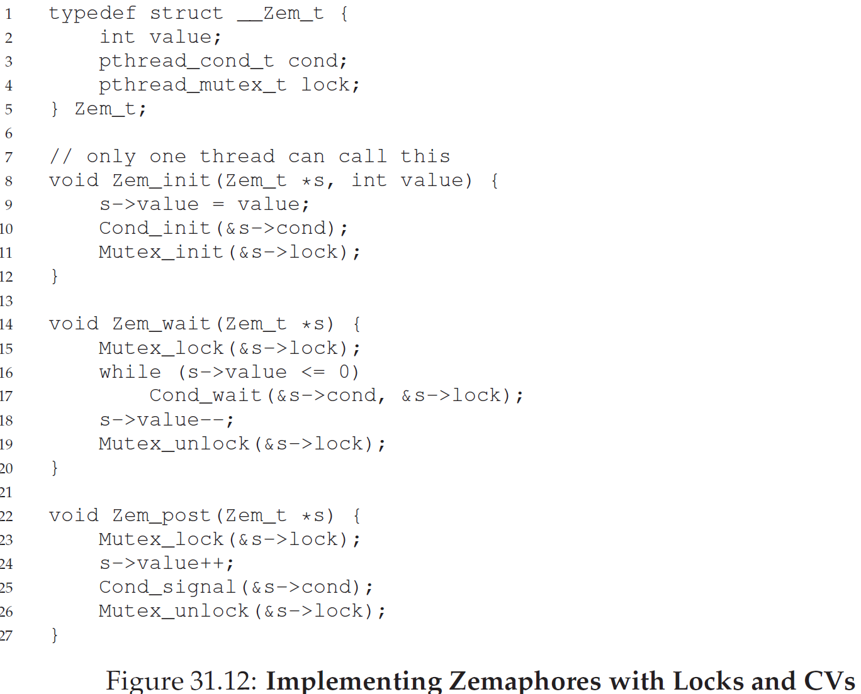
Zemaphore implementation

